Slide 1
DESIGN AND IMPLEMENTATION OF EFFICIENT TRAVEL PLANNING MANAGEMENT SYSTEM USING RPA
Team Members
1. Prakathi.P [711715104046]
2. Suvetha.S [711715104061]
3. Senthilnathan.J [711715104053]
Faculty Guide :
Dr.S.K.Mydhili Industrial Guide : Ms.Pavithra
Professor Designation
Department of CSE
Department of CSE, KGiSL Institute of Technology, Coimbatore

Slide 2
Agenda
Abstract
Objective
Introduction
Literature survey
System Architecture
Equalization
Conclusion

Slide 3
Abstract
Many travel packages are existing from different websites to almost all the places over the world.
For frequent travellers, receive the ticket availabilities through mail notifications based on their frequent booking locations.
It will be helpful for them to plan their travel accordingly.
Robotic Processing Automation (RPA) is an emerging form of business process automation technology based on the notion of software robots or artificial intelligence workers. .
Department of CSE, KGiSL Institute of Technology, Coimbatore

Slide 4
Objective & Outcome
Objective
The objective of the project is to develop a system that automates the processes and activities of a travel agency.
Expected Outcome:
Users can decide about places they want to visit and make bookings online for travel and accommodation.

Slide 5
Introduction
RPA
-RPA stands for Robotic Process Automation.
-The process of automating business operations with the help of robots to reduce human intervention is said to be Robotic Process Automation(RPA).
Robotic
-mimic human actions.
process
-sequence of steps.
Automation
-done by a robot without human intervention.

Slide 6
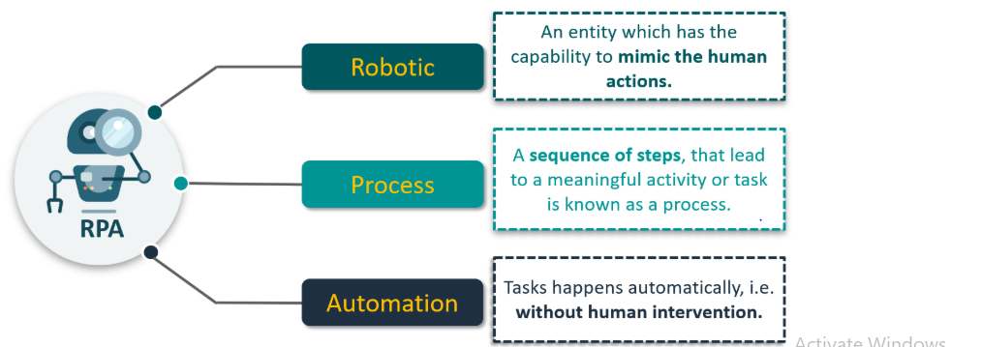

Slide 7
Role of RPA -Robotic Process Automation (RPA) emerging as software based solution to automate rules-based business processes that involve routine task, structured data and deterministic outcome. -Recent studies report the benefit of the application of RPA in terms of productivity, costs, speed and error reduction -RPA stands for Robotic Process Automation is the application of technology that allows employees in a company to configure computer software or a “robot” to capture . -Interpret existing applications for processing a transaction, manipulating data, triggering responses and communicating with other digital systems.
Department of CSE, KGiSL Institute of Technology, Coimbatore

Slide 8
Existing System -In the existing manual system of travel management, much time and money is wasted in reservation of bus or plane to destination, hotel at destination, etc. -It involves a lot of manual paper works and the customers need to stay on queue for a long time. -To root out such drawbacks of travel agencies, the whole system of management requires to be automated using computer and internet technology. - Implemented in Android APP using JAVA
Department of CSE, KGiSL Institute of Technology, Coimbatore

Slide 9
Proposed System -An attempt to overcome the drawbacks of the existing system, the whole system of management is automated using computer and internet technology. - Implemented in RPA using Ui Path
Department of CSE, KGiSL Institute of Technology, Coimbatore

Slide 10
Literature
TITLE | PUBLICATION YEAR | PUBLISHER | DESCRIPTION
Web and mobile based tourist travel guide system for fiji's tourism industry | 2014 | IEEE | The tourism sector is leading Fiji's Economy. There are limited technologies are used in this sector.
Developing a Creative Travel Management System Based on Software Reuse and Abstraction Techniques | 2017 | IEEE | Tourism became a common topic while the level of tourist requirements increased dramatically.

Slide 11
TITLE | PUBLICATION YEAR | PUBLISHER | DESCRIPTION
Travel management system using GPS & geo tagging | 2016 | IEEE | This application will also be used by travelling agencies to manage their customer trips, acquire information, etc
Travel Management System | 2017 | IEEE | The main objective of this project is to create a fast, effective and reliable.

Slide 12
TITLE | PUBLICATION YEAR | PUBLISHER | DESCRIPTION
Travel Planner | 2016 | IEEE | Most traveler need to plan prior their traveling for energy saving and visiting maximum places of interest within the specific travel time.
Augmented Reality Based Mobile Travel Guide System | 2015 | IEEE | There is greatly enriched travel information provided to the tourists on the Internet.

Slide 13
Proposed System Advantages over existing method - There should be system where the customer should find the best package through mail notification with a single click - Using a ‘drag and drop’ method you can shape and create a workflow that is easy to understand. Future Enhancements Implementation of notification processing through message in upcoming years. The drawbacks of existing methods , - Network traffic . -Process is not applicable to all. - Not in offline process.
Department of CSE, KGiSL Institute of Technology, Coimbatore

Slide 14
Architecture diagram
.
Database
User
RPA
Admin

Slide 15
Flowchart
Start
Ticket avabile
Book ticket
Personal details
Payment
Yes/no
Ticket details
Cancel
Refund

Slide 16
UiPath:
UiPath is a Robotic Process Automation tool which is used for Windows desktop automation.
It is used to automate repetitive/redundant tasks and eliminates human intervention.
The tool is simple to use and has a drag and drop functionality of activities.
UiPath has a standard Studio version which has a trial period of 60 days.
The best part is, UiPath also comes with a Community Edition which is free for lifetime and has most of the functionality of the Studio version.

Slide 17
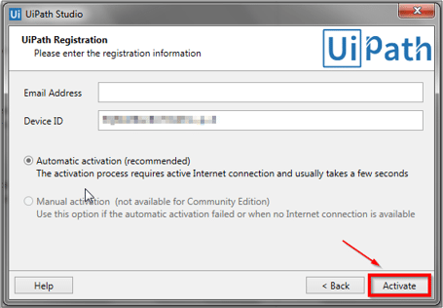
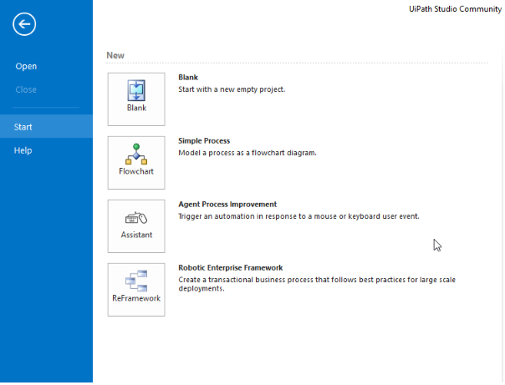
Screenshots

Slide 18
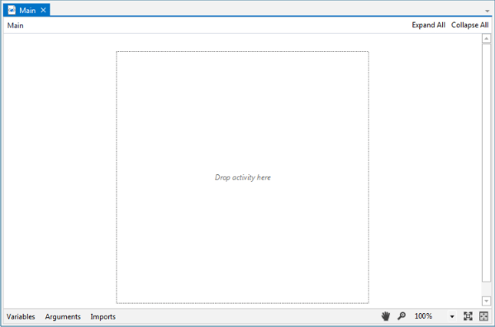

Slide 19
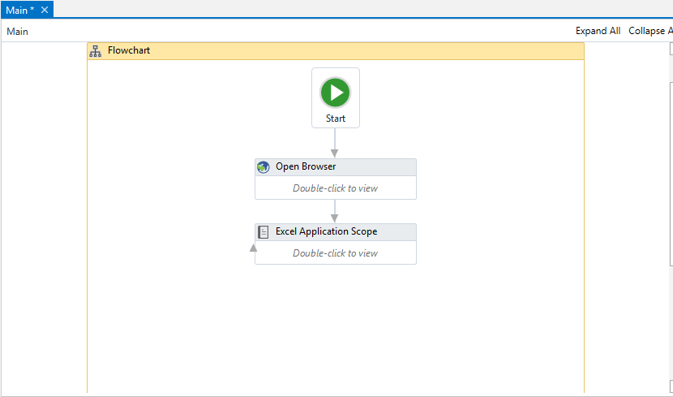

Slide 20
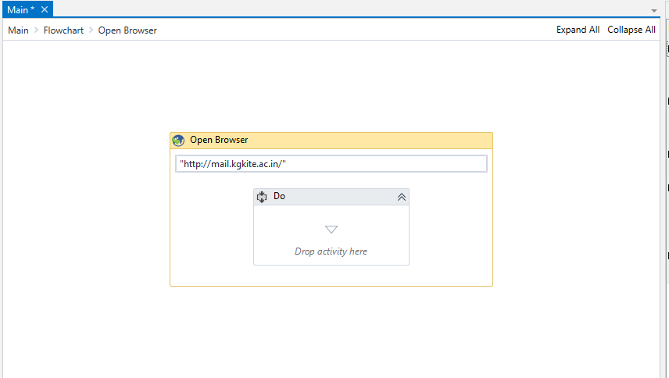

Slide 21
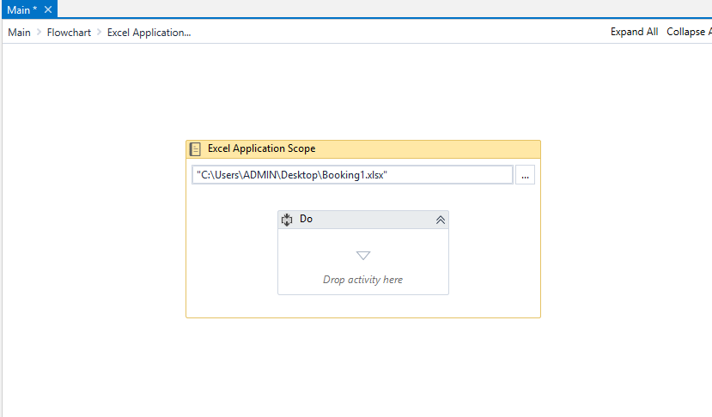

Slide 22
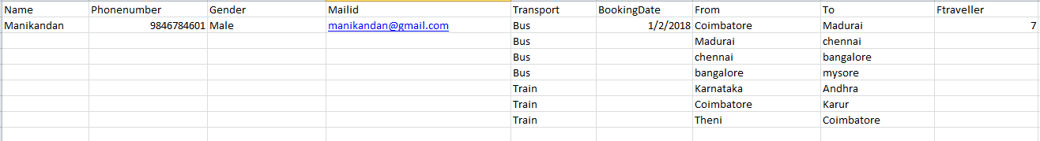

Slide 23
Conclusion -To computerize the different operations in travel agencies - is very flexible and secured -Admins can incorporate new features and manage the modules of the system as per the requirements -Being a web-based software, it can be accessed from anywhere with internet.
Department of CSE, KGiSL Institute of Technology, Coimbatore

Slide 24
Reference [1]Vineet Singh School of Computing Science, Information System and Mathematics, The University of the South Pacific, Laucala Bay, Suva, Fiji [2]Akeshnil Bali School of Computing Science, Information System and Mathematics, The University of the South Pacific, Laucala Bay, Suva, Fiji [3]Avinesh Adhikthikar School of Computing Science, Information System and Mathematics, The University of the South Pacific, Laucala Bay, Suva, Fiji [4]Rohitash Chandra School of Computing Science, Information System and Mathematics, The University of the South Pacific, Laucala Bay, Suva, Fiji Citation Map April 2013, [online] Available: FijiAccommodation.onlinetravel.com. https://ieeexplore.ieee.org/document/8029967 [5]B. Brown, M. Chalmers, "Tourism and mobile technology", pp. 339, 2003. https://ieeexplore.ieee.org/search/searchresult.jsp?newsearch=true&queryText=Travel%20panning https://ieeexplore.ieee.org/document/7759019

Slide 25
[6] M. Gordon, M. Paprzycki, "Designing Agent Based Travel Support System". G. M, P. M., "Designing Agent Based Travel Support System", Parallel and Distributed Computing, 2005. [7] P. Maes, "Agents that Reduce Work and Information Overload", Communications of the ACM, vol. 37, no. 7, pp. 31-40, 1994. [8] M. Paprzycki, A. Abraham, "Agent Systems Today; Methodological Considerations", in: Proceedings of 2003 International Conference on Management of e-Commerce and e-Government Jangxi Science and Technology Press, pp. 416-421, 2003. https://ieeexplore.ieee.org/document/7759019 [9] H. Nwana, D. Ndumu, "A perspective on software agents research", The Knowledge Engineering Review, vol. 14, no. 2, pp. 1-18, 1999. [10]D. Ndumu, J. Collins, H. Nwana, "Towards Desktop Personal Travel Agents", BT Technological Journal, vol. 16, no. 3, pp. 69-78, 1998. Travel Market: Real-Life Application of the FIPA Standards", Technical Report BT Project AC317, 1999. [11] M. Umlauft, G. Pospischil, G. Niklfeld, E. Michlmayr, H. Werthner, E. Veit, "LoL@ a Mobile Tourist Guide for UMTS" in Journal on Information Technology & Toursim, Congnizant, vol. 5, no. 3, pp. 151-164, March 2003.

Slide 26
Thank You
Department of CSE, KGiSL Institute of Technology, Coimbatore

